Slide 1




CYBERSECURITY Final Project
SecuritateIT.com
Romanian Cyber Security School
Student: Denie Radu
2026, April

Slide 2
Project Objectives
Main goal | Building a vulnerable website and securing it
Objective 1 | Identifying web vulnerabilities
Objective 2 | Demonstrating real attacks (SQL Injection, XSS,MITM brute force)
Objective 3 | Applying security measures
Objective 4 | Comparing results before and after securing
Final objective | Understanding the complete penetration testing process

Slide 3
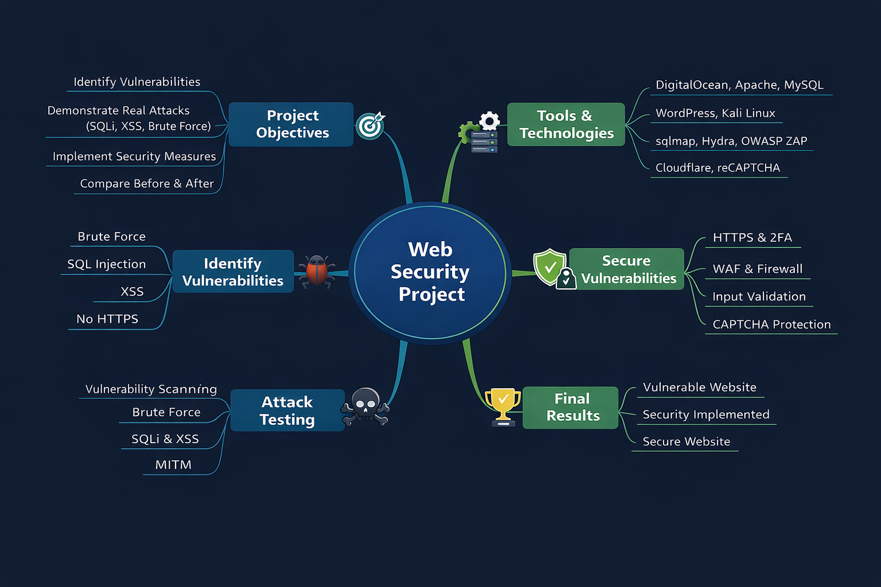

Brain Map

Slide 4



Software and Technologies Used
Category | Tools
Infrastructure | DigitalOcean, Ubuntu
Web Server | Apache / Nginx
Database | MySQL
CMS | WordPress (custom theme)
Attacking Machine | Kali Linux
Attack Tools | sqlmap, Hydra, Burp Suite, OWASP ZAP, Nikto, Wireshark
Security Tools | Cloudflare, Certbot, Google reCAPTCHA, Wordfence
Other Measures | Security Headers

Slide 5
Vulnerability Identification
Vulnerability Type | Description | Impact
Brute Force | Weak passwords | Compromised accounts
SQL Injection | Unsecured query | Database access
XSS | Injected scripts | Code execution in browser
No HTTPS | Unencrypted data | Traffic interception (MITM)
No CAPTCHA | Lack of bot protection | Mass spam
File Upload Exploit | Malicious file upload | Server control
Directory Traversal | System file access | Data exposure

Slide 6
Testing (Demonstrated Attacks)
Test Type | Tool | Purpose
Vulnerability Scanning | OWASP ZAP, Nikto | Detect issues
Brute Force | Hydra | Password cracking
SQL Injection | sqlmap | Database access
XSS | Burp Suite | Input testing
MITM | Wireshark | Traffic interception
WordPress Scan | WPScan | CMS vulnerabilities

Slide 7
Securing Vulnerabilities
Solution | Technology | Result
HTTPS | Certbot | Encrypted traffic
Bot Protection | Google reCAPTCHA | Spam blocking
Secure Login | Wordfence | 2FA + login attempt limiting
Input Validation | Prepared statements | Eliminates SQLi and XSS
Firewall | Cloudflare | WAF and DDoS protection
Security Headers | CSP, HSTS | Browser security

Slide 8
Final Results
3. Demonstrate attaks
2. Scan for vulnerabilityes
4. Implement Security
1. Deploy vulnerable website
5. Re-scan System
Before Result | Vulnerable system
After Result | Secured system
Conclusion | Significant improvement in security

